Slide 1
Artificial Intelligence III
Mária Markošová

Slide 2
Previous lecture
Planning basic definitions.
Sensorless planning and planning in the stochastic environment.
Planning in the classical planning environment, STRIPS representation, totally ordered plan, partially ordered plan.
Planning with time – scheduling, critical path method

Slide 3
Outline
Probability theory and AI I– short repetition of the basic probability concepts.
Point and interval estimate.
Probability in AI I. Monte Carlo simulations.
MC simulation, direct sampling, Metropolis sampling.
MC simulations rejection sampling.
MC examples.

Slide 4
Probability - short repetition
If we have a probabilistic domain, we can describe this domain by the set of random variables.
Example: Domain name Climate. This domain is described by one random variable.
Random variable name : Weather. Set of possible values of the random variable
{sunny, wind, snow, rain}.
Convention for us: Random variable name starts by a capital letter. Value of
the random variable starts by a small letter.
Weather = sunny
Random variable Weather is a discrete random variable.
Name of the random variable
Value of the random variable

Slide 5
Another example: Domain Health is described by two random variables Cavity and Toothache.
Both random variables are Boolean, that means they have only two possible values {0,1}, {false, true}.
Atomic event: Both variables gained values: Cavity=true, Toothache=false
or Cavity=1, Toothache =0
Joint probability : is a probability of the atomic event.
Convention for the Boolean random variables:
P(Cavity=x, Toothache=y)
x,y=true, false

Slide 6
If the probability of all atomic events in the domain are specified, we have full joint probability distribution (distribúcia úplnej vzájomnej pravdepodobnosti) specified. This is good, because in such case we know all about the domain and can make whatever inference we need.
All atomic events in the domain Health
Cavity = false ∧Tootache = false
Cavity = false ∧ Tootache = true
Cavity = true ∧ Tootache = false
Cavity = true ∧ Tootache = true
Joint probability distribution in the domain Health
P(Cavity = false ∧Tootache = false)=0.7
P(Cavity = false ∧ Tootache = true)=0.05
P(Cavity = true ∧ Tootache = false)=0.05
P(Cavity = true ∧ Tootache = true)=0.2

Slide 7
Unconditional probability : It is a probability, that a given event will take place, regardless of other occurrences or other events. For example probability of the Cavity=true, regardless of the fact, whether a patient has or has not a toothache.
It is our believe about the probability of the event. For example if I say a name of the student at this faculty, what is the probability his weight is 90 kg. This can be estimated from the sample of the students as
P=N(90 kg students)/N(all students)
where N(90 kg students) is a number of students having 90 kg and N(all students) is a number of all students in the sample.

Slide 8
Conditional probability
P(A/B)=P(A,B)/P(B)
A=Cavity
B=Toothache
Masurement
Let us measure 100 patients: N=100
N(A=1,B=1) number of patient having cavity and toothache together
Cavity have N(A=1) patients. Toothache has N(B=1) patients.
P(cavity/tootache)=P(Cavity=1/Tootache=1)=P(Cavity=true/ Tootache=true)=0.8
All possibilities for the Boolean variables denotes the same.

Slide 9
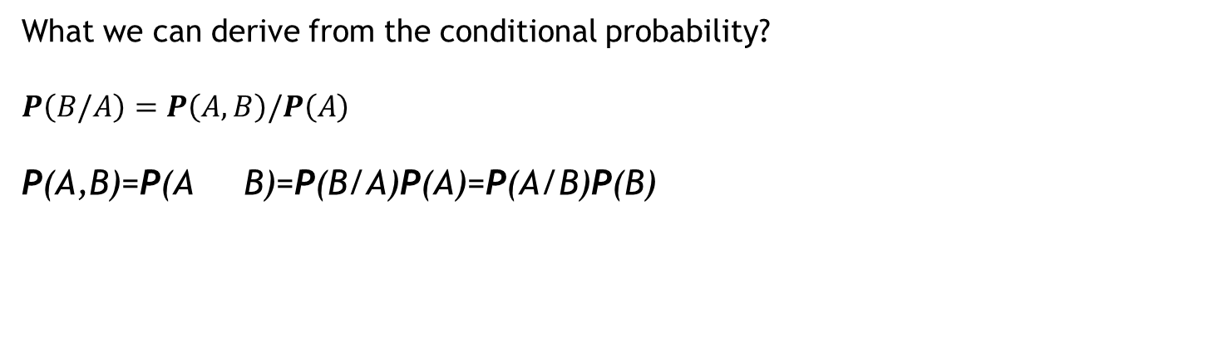
P(A/B)=P(A,B)/P(B)
What we can derive from the conditional probability?
$$P\left(B/A\right)=P\left(A,B\right)/P\left(A\right)$$
P(A,B)=P(A B)=P(B/A)P(A)=P(A/B)P(B)
Bayes rule
If I denote P(A) and A is a Boolean variable, this represents all values of A. If I denote P(A=1), then it is a value, number.

Slide 10
Independence: If the random variable A and the random variable B are independent, then
Conditional independence:
We introduce another Boolean random variable to the Health domain, Catch
P(Tootache, Catch | Cavity) = P(Tootache | Cavity) P(Catch | Cavity)
Consequences are mutually independent, they are dependent only through cause. We say, that consequences are conditionally independent.
Cause
Cavity
Tootache
Catch
Consequences

Slide 11
Formulas for the conditional independency
P(Tootache | Catch, Cavity) = P(Tootache | Cavity)
P(Catch | Tootache, Cavity) = P(Catch | Cavity)
P(Tootache, Catch | Cavity) = P(Tootache | Cavity) P(Catch | Cavity)

Slide 12
Summary
Variables: Discrete
Continuous
Binary , boolean
Atomic event: each random variable describing probabilistic domain takes a value (Cavity=1, Tootache=0, for example).
Probability of the atomic event : P(Cavity=1, Tootache=0, for example).
If the probability of all atomic events in the domain are specified, we have full joint probability distribution specified.
Conditional probability:
Independence:
Conditional independence:
P(A/B)=P(A,B)/P(B)
P(Tootache | Catch, Cavity) = P(Tootache | Cavity)
P(Catch | Tootache, Cavity) = P(Catch | Cavity)
P(Tootache, Catch | Cavity) = P(Tootache | Cavity) P(Catch | Cavity)

Slide 13
Probability theory in AI I. To repeat the basic concepts, let us solve some tasks
Tossing a fair coin: each side of the coin has the same probability, h- head, t -tail
What is the probability of P(h,h,h,h)?
What is the probability ?
What is the probability if in a series of 4 tosses we have 3 or more h?
Possibilities are hhhh, thhh, hthh, hhth, hhht. Each has a probability 1/16, so the result is 5/16.

Slide 14
More complex task
We have two coins, number one is fair. Number two is not.
Let and .
What is ?
In general:

Slide 15
Interval and point estimation (according Shubham Mehta, https://www.slideshare.net/ShubhamMehta5/point-and-interval-estimation-56832707)
Statistical population: population on which we want to know a desired parameter. Example / average age of the population in our country.
Sample: is drawn from the population, usually to estimate a desired parameter on the basis of the sample measurements.
Point estimation: We use a sample data, or a measurement to calculate a best single value estimating an unknown population parameter.
Example: Population: students of our faculty, parameter we want to estimate is an average weight of the students on the basis of measuring the weights of a sample of 100 students .
Interval estimation: We use a sample data to calculate an interval in which is an unknown population parameter (for example the average weight of the students) with certain probability (confidence interval).

Slide 16
Estimators
Estimator is a function of the sample data used to estimate an unknown population parameter. Example: we estimate an average age of the people in our country on the basis of an age measurement on the sample of 10000 people.
Properties of estimators: unbiased – expected value given by the estimator is equal to
the estimated parameter
consistent – unbiased estimator is consistent if the difference
between estimated and real parameter decreases with the
increasing sample size

Slide 17
Estimation
The goal of estimation is to find an approximate value of the population parameter on the basis of the sample statistics.
Point estimator: gives a number, an approximate value, of the estimated parameter
Interval estimator: gives an interval, in which the population parameter is with certain confidence.

Slide 18
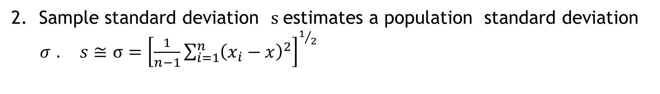
Point estimators
1. Sample mean $x$estimates a population mean $μ. μ≅x=\frac{1}{n}\sum_{i=1}^{n}{x_{i}}$
2. Sample standard deviation $s$estimates a population standard deviation
$σ$ $. s≅σ={\left[\frac{1}{n−1}\sum_{i=1}^{n}{{\left(x_{i}−x\right)}^{2}}\right]}^{1/2}$
3. Sample proportion estimates population proportion.
If we draw more then one sample, on the basis of each one we get different estimates.

Slide 19
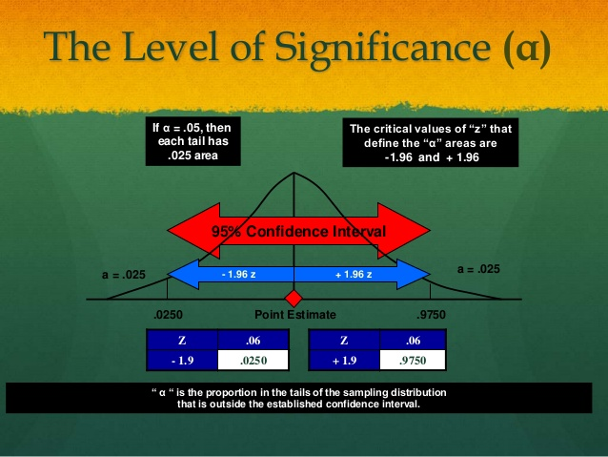
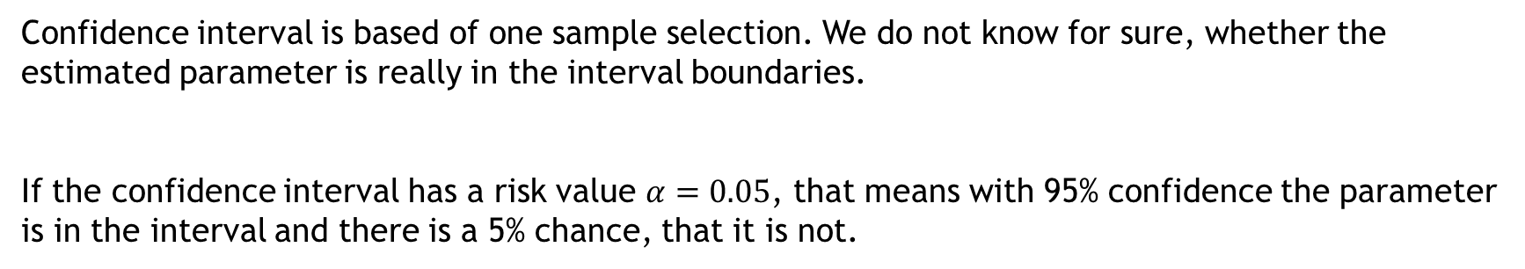
Confidence interval and the level of significance
Confidence interval is based of one sample selection. We do not know for sure, whether the estimated parameter is really in the interval boundaries.
If the confidence interval has a risk value $α=0.05$, that means with 95% confidence the parameter is in the interval and there is a 5% chance, that it is not.

Slide 20

If we draw more then one sample from the population:
For each sample, we get different confidence intervals.
95% confidence interval means, that if we draw 100 samples, 95 of the calculated intervals, each built on the different sample, will contain the estimated parameter.
General formula for the confidence interval construction:
Point estimate$±(z critical value)(standard deviation of the sample)$
Sample mean for example
tabelized value
$σ/\sqrt{n}$

Slide 21
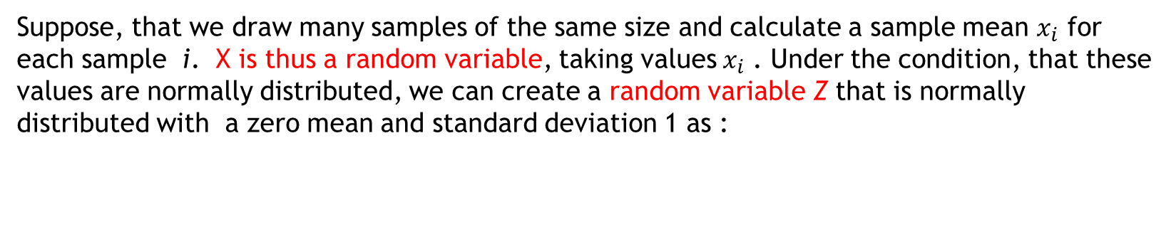
How to get the general formula? Let us demonstrate on the population mean estimation.
Suppose, that we draw many samples of the same size and calculate a sample mean $x_{i}$ for each sample i. X is thus a random variable, taking values${ x}_{i}$ . Under the condition, that these values are normally distributed, we can create a random variable Z that is normally distributed with a zero mean and standard deviation 1 as :
These values we know from the tables for such normal distribution and are called Z –scores.

Slide 23
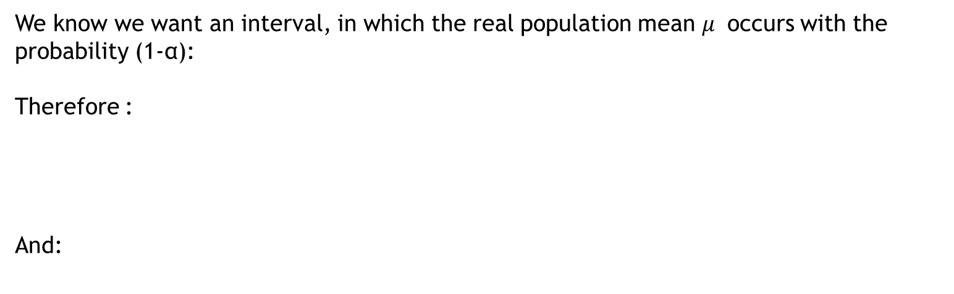
We know we want an interval, in which the real population mean $μ$ occurs with the probability (1-α):
Therefore :
And:
Confidence interval is thus:
Point estimate$±(z critical value)(standard deviation of the sample)$

Slide 24
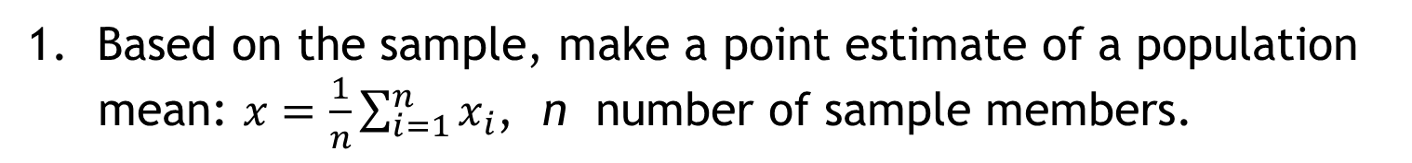
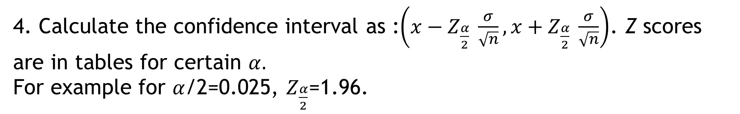
How to construct a confidence interval
Let us estimate a population mean on the basis of one sample.
Based on the sample, make a point estimate of a population
mean: $x=\frac{1}{n}\sum_{i=1}^{n}{x_{i}}$, n number of sample members.
2. Decide about the level of confidence.
Calculate $\frac{σ}{\sqrt{n}}.$
4. Calculate the confidence interval as :$\left(x−Z_{\frac{α}{2}} \frac{σ}{\sqrt{n}}, x+Z_{\frac{α}{2}} \frac{σ}{\sqrt{n}}\right)$. Z scores are in tables for certain $α.$
For example for $α$/2=0.025, $Z_{\frac{α}{2}}$=1.96.

Slide 25
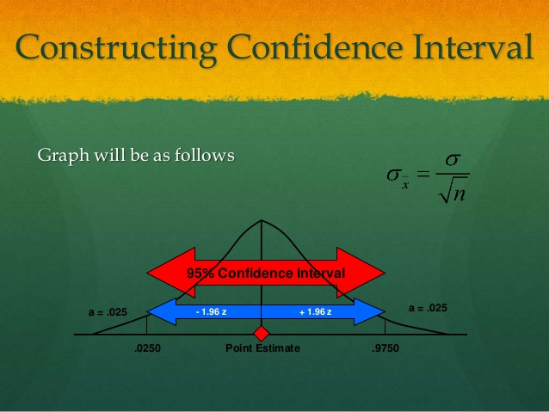

Slide 26
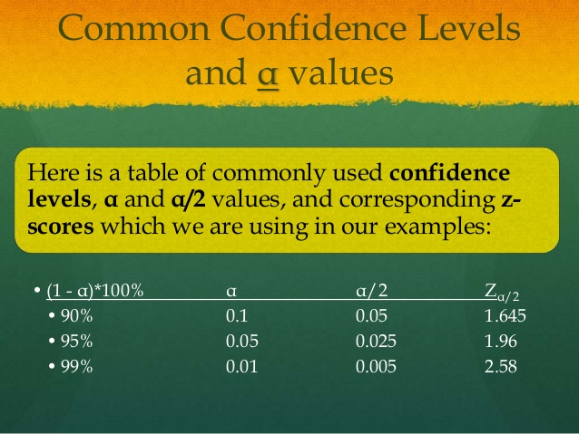

Slide 27
Monte Carlo method
Concept of Monte Carlo contains stochastic methods, that means methods using random numbers, probability, statistics sampling and point and interval estimates to solve the problems.
Where to use MC method: MC method is used to solve physical, chemical, mathematical and AI problems.
MC method in AI : mainly in games

Slide 28
A bit of history
Monte Carlo method has been created by the mathematician Stanislaw Ulam in 1946. Ulam was of Polish origin. He worked with famous mathematician John von Neumann. MC method was found as an effort to estimate of the win probability in a card game Solitare. The name the method get comes from the city of games Monte Carlo.

Slide 29

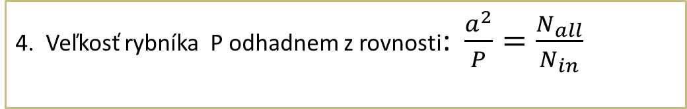
We want to measure the size of a lake. It is difficult so we want to estimate it as well as possible.
Principle of the MC method
Close the lake into a square area with known edge (edge lenght is a).
Take a bowl full of small stones and toss them randomly into the square area.
Number of all stones
The lake area P can be estimated as
Number of stones which have fallen into the lake

Slide 30
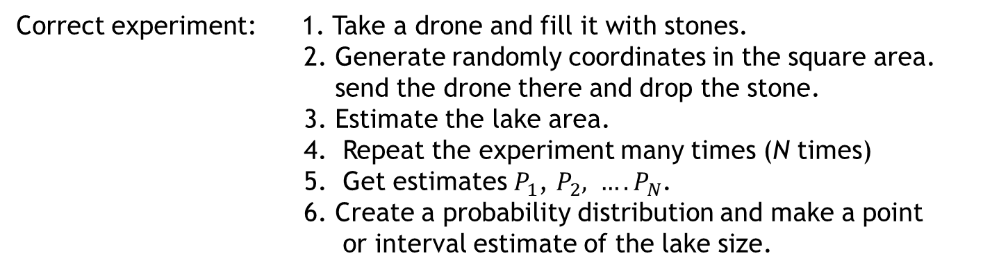
What we in fact did? Is it a correct simulation. If not, why?
Not quite correct.
Because we tossed the stones from one place only (biased simulation).
Because we made only one experiment
Correct experiment: 1. Take a drone and fill it with stones.
2. Generate randomly coordinates in the square area.
send the drone there and drop the stone.
3. Estimate the lake area.
4. Repeat the experiment many times (N times)
5. Get estimates $P_{1}$, $P_{2}, …. P_{N}$.
6. Create a probability distribution and make a point
or interval estimate of the lake size.
Such method is called direct sampling.
Correct sampling is decisive for the Monte Carlo simulation.

Slide 31
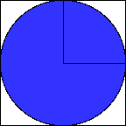
Some simple direct sampling examples
r
MC Pi estimate
y
x
Close a circle by a square with the edge 2r, where r is a circle perimeter. With a help of random number generator generate randomly points (their coordinates) in the square. N1 points are in a square and N2 in a circle. Their number is proportional to the square and circle area. So we can calculate:
Estimate is more accurate if we create many points. Of course experiment should be repeated many times, to get many Pi estimates and to create their probability distribution.

Slide 32
Integration with a help of Monte Carlo direct sampling
We want to calculate integral in the interval (a, b) from the complicated function.
f(x)
k
x
a
b
Generate uniformly distributed random numbers inside the rectangle (coordinates x, y of the points).
Calculate how many points are inside rectangle and inside the area under the functional curve.
It holds
Number of points under the curve
Number of points in the rectangle

Slide 33
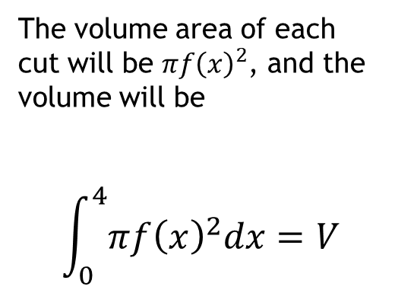
Calculating a volume of a complex shapes (motivation for exercises)
Let us calculate a volume of geometrical body created by a rotation of f(x)=0.2 x*x+2,
in the interval $\left\langle 0,4\right\rangle$.
5
4
The volume area of each cut will be ${πf\left(x\right)}^{2}$, and the volume will be
$$\int_{0}^{4}{{πf\left(x\right)}^{2}dx=V}$$
y
3
f(x)
2
1
0 1 2 3 4
x

Slide 34
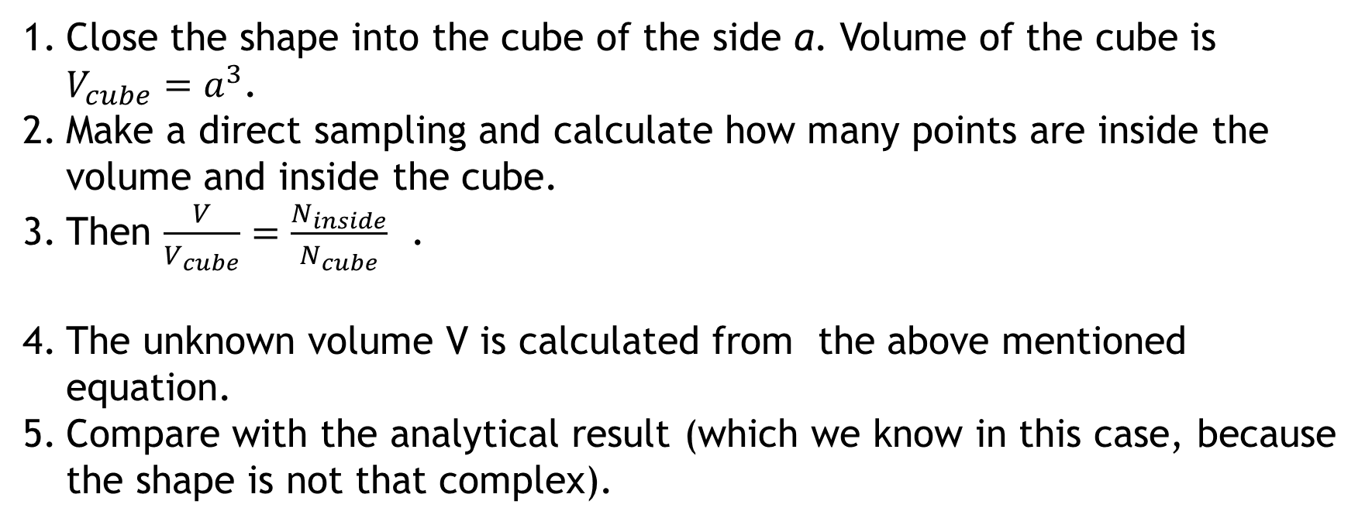
How to calculate volume with a help of MC simulations?
Close the shape into the cube of the side a. Volume of the cube is $V_{cube}=a^{3}$.
Make a direct sampling and calculate how many points are inside the volume and inside the cube.
Then $\frac{V}{V_{cube}}=\frac{N_{inside}}{N_{cube}}$ .
The unknown volume V is calculated from the above mentioned equation.
Compare with the analytical result (which we know in this case, because the shape is not that complex).

Slide 35
Markov chain (Metropolis) sampling:
It is not always possible to use direct sampling. For example, if the lake has a peculiar shape (see the picture), there are some areas, which may not be covered by direct sampling uniformly.
Some parts of the lake are not always well represented by the direct sampling simulation. Therefore we need better sampling which has not these disadvantage, the so called Metropolis sampling algorithm.
Some experiments are rejected, because the sample is at the boundary or the stone goes out of the closed boundary.
This narrow stripe can be completely omitted by the direct sampling.

Slide 36
Metropolis (Markov chain) sampling principle:
Start for example in the right edge of the square, or rectangle.
“With a closed eyes” toss a stone in a random direction. Make the tosses rather short.
Go to the place where your stone fell and from this position repeat 2. The process is repeated.
If the stone goes out of the rectangle boundary, take it and put it on the place from were it has been previously tossed.

Slide 37

Result of the simulation: On the square boundaries, especially on the corners the stones are piled. No toss is rejected and this sampling gives a good results.
Why the results are so good?

Slide 38
Detailed balanced condition – why the stones are piled on edges.
Let us simplify our sampling. Divide the rectangle into 9 smaller squares, possible stone positions. Let us suppose, the stone can be thrown only in 4 directions south, east, west and north.
a
b
Configurations a,b,c.
c

Slide 39







Configurations
$$p\left(a→a\right)$$
b a
Transition probabilities among the configurations x and y.
p$\left(a→a\right)$ +
p$\left(a→b\right) +$
p$\left(a→c\right)$ =1
c

Slide 40







Configurations
b a
p$\left(a→a\right)$ +
p$\left(a→b\right) +$
p$\left(a→c\right)$ =1
Probability to be in the configuration a
p$\left(a→a\right)$ +
p$\left(a→b\right) +$
p$\left(a→c\right)$ =1
c

Slide 41
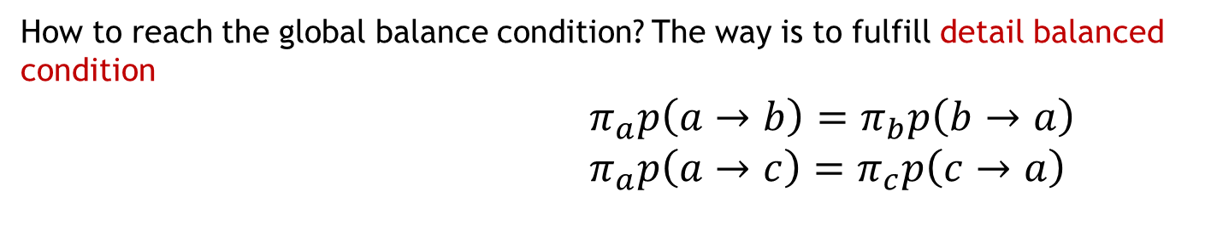
Result:
Global balance condition, which should held for sampling by the markov chain.
How to reach the global balance condition? The way is to fulfill detail balanced condition
$π_{a}p\left(a→b\right)=π_{b}p\left(b→a\right)$
$π_{a}p\left(a→c\right)=π_{c}p\left(c→a\right)$

Slide 42


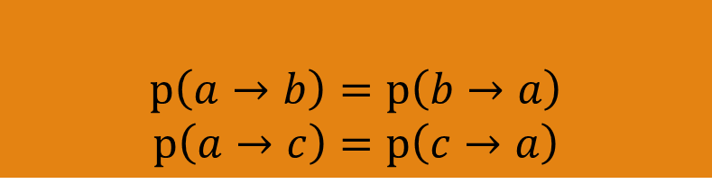
We are sampling from the uniform distribution, we want therefore sample all configurations uniformly and thus we want
Taking this and detail balance condition into account we get:

Slide 43
The condition is fulfilled if all transition probabilities to all 4 sides are the same, equal to ¼.
The probability, that the stone stays on the place is ½ here.
Here the probability, that the stone stays on the place is 1/4.
This explains why stone distribution is not uniform at the boundaries and in the edges of the square. For Metropolis sampling it is crucial to take into account detailed balanced conditions.

Slide 44
In a case of our game with stones we have sampled from the uniform distribution, because no part of the lake is more important then the other.
Let us imagine, that the bottom of the lake is at some places created from the iron stone and we do not toss stones but small magnets. That means some configurations are more probable then the others. How to do Metropolis sampling correctly in this case? In our simplified world it means we have different probabilities of the configurations.
2 0.5 1.0
Numbers in small squares are ratios. In the left upper corner the small magnets are placed twice as much as in the right upper corner.
0.5 1.0 0.5
3 0.5 1.0

Slide 45
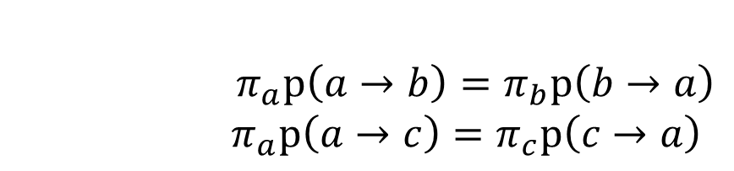
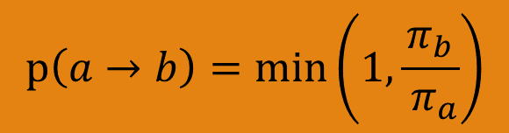

Metropolis accepting criterion:
2 0.5 1.0
0.5 1.0 0.5
To fulfill detail balance conditions, the transition probabilities should be defined according Metropolis accepting criterion, for example:
3 0.5 1.0

Slide 46
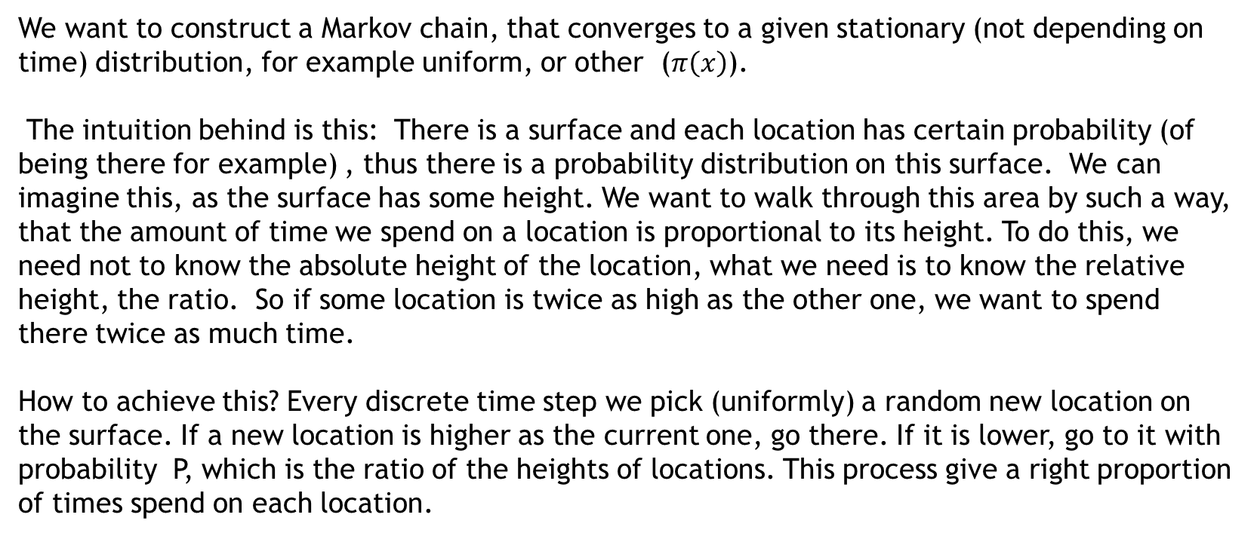
Metropolis sampling in general
We want to construct a Markov chain, that converges to a given stationary (not depending on time) distribution, for example uniform, or other ($π\left(x\right)$).
The intuition behind is this: There is a surface and each location has certain probability (of being there for example) , thus there is a probability distribution on this surface. We can imagine this, as the surface has some height. We want to walk through this area by such a way, that the amount of time we spend on a location is proportional to its height. To do this, we need not to know the absolute height of the location, what we need is to know the relative height, the ratio. So if some location is twice as high as the other one, we want to spend there twice as much time.
How to achieve this? Every discrete time step we pick (uniformly) a random new location on the surface. If a new location is higher as the current one, go there. If it is lower, go to it with probability P, which is the ratio of the heights of locations. This process give a right proportion of times spend on each location.

Slide 47
Artificial data and rejection sampling
Imagine, that we want to train an agent to play certain game. To do that, we need to simulate a results of the game (artificial data) from a known probability distribution.
We know the probability distribution of the game results (that means we know the probability of each result for certain starting conditions). We can gain this by such a way that we let a lot of players to play the game. Often the situation is such, that the programmer gets the distribution and needs to create artificial data to train an agent.

Slide 48
P(v)
Initial conditions
V1
V2
V3
V4
V5 ...

Slide 49
Simplified situation for one initial configuration
2. For the game agent we need a lot of training data. Therefore we need to simulate a game results from the known distribution, which is very complex. To generate the results from this distribution is difficult.
P(v)
Difficult sampling from this distribution.
V1
V2
V3
V4
V5 ...

Slide 50
How to sample?
Find a distribution from which to sample is easy. For example the uniform distribution. Give each result the same probability.
Enclose a complex distribution into a rectangular area.
For each result draw a line.
With a help of random generator generate points with coordinates (v,y).
Accept only the points under the curve . Reject other points.
P(v)
V1
V2
V3
V4
V5 ...

Slide 51
Generalization – to create the artificial data, we can use whatever other distribution from which it is easy generate samples (for example Gaussian distribution).
P(v)
V1
V2
V3
V4
V5 ...

Slide 52
Problems with the rejection sampling method
RS is not appropriate if one samples from the multidimensional distribution, because a lot of samples are rejected.
P(v)
y
x
A lot of samples are from the inappropriate areas .

Slide 53
Summary
Basic probability concepts
Principle of the Monte Carlo simulations
Direct sampling and Metropolis sampling.
Rejection sampling.

